Slide 1
Memo on Optical Connections
A. Pellegrino
Nikhef, 3-Sep-2020
To/From Host
TTC

Slide 2
Useful Links
Nikhef Redmine https://redmine.nikhef.nl/et/projects/atlas-felix/wiki/Atlas_setup_in_H148
Kept up to date by Frans
Jos’public page https://www.nikhef.nl/~i73/Testlab.html
Kept up to date by Jos

Slide 3
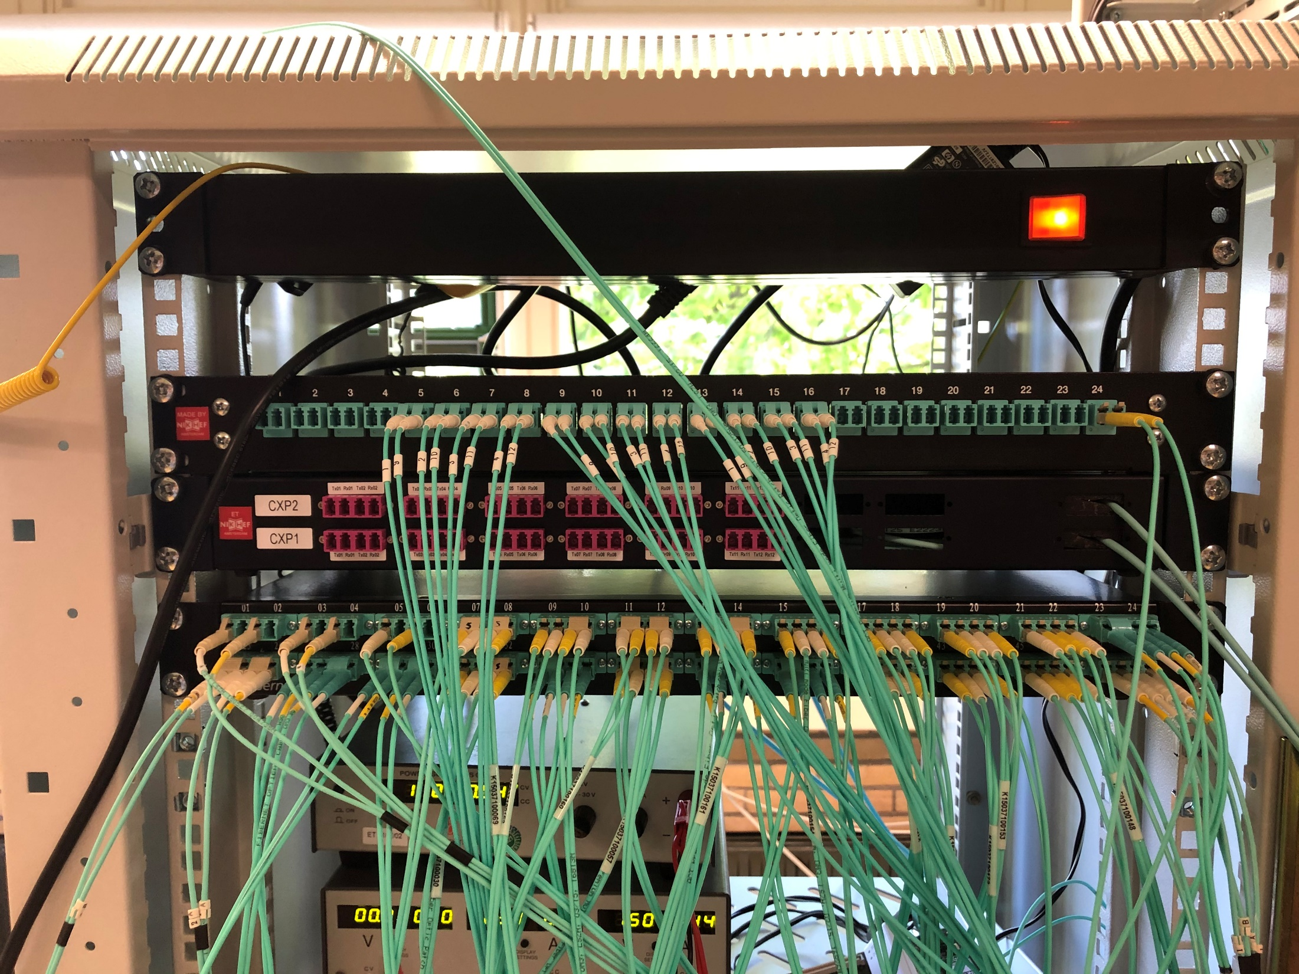
Optical Breakout Panels MPO↔LC
1.
2.
3.

Slide 4
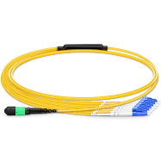
MPO↔LC PP 1
MPO side: 48× Tx/Rx-crossed to TURANO Prime FLX-712
1-9
2-10
3-11
4-12
5,6,7,8 n.u.
1-9
2-10
3-11
4-12
5,6,7,8 n.u.
1-9
2-10
3-11
4-12
5,6,7,8 n.u.
MTP to 6 LC Duplex
This is the only one actually used, by JJ’s VLDB
Unplugged 40GB QSFP+ Fiber-Optics Transceiver
Unplugged 40GB QSFP+ Fiber-Optics Transceiver
Unplugged 40GB QSFP+ Fiber-Optics Transceiver

Slide 5
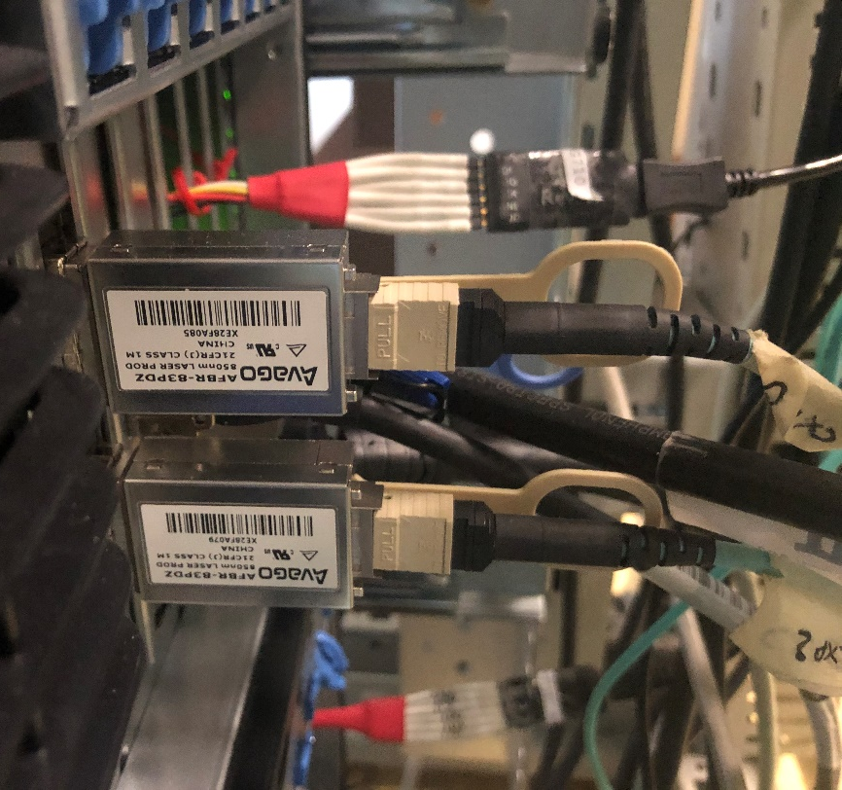
MPO↔LC PP 2
Avago AFBR-83PDZ Fiber-Optic CXP Transceiver with 12 lanes in each direction for short-range multi-lane communication and interconnect (e.g. 100GbE and 12×10G IB-QDR), each lane capable of operating at 10.3125 Gbps up to 100m (resp. 150m) using OM3 (resp. OM4) fiber (>120Gbps aggregate bandwidth) over multimode fiber systems using a nominal wavelength of 850 nm. The optical interface uses a 24-fiber MPO connector.
MPO side: 2×12duplex to ARGOS HGT-710
NO LC used anywhere

Slide 6
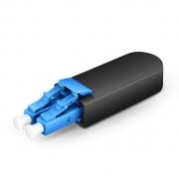
MPO↔LC PP 3-1
MPO side: (48× Tx/Rx-crossed?) to AGOGNA (BNL-712?)
Simplex connection from MROD LC Data Tx
N.U.
Henk’s VLDB
used to test the simplex transmission CSMs → FELIX-MROD. In this case, the regular MROD is used as external data generator, emulating the data output from the CSM (Chamber Service Modules)

Slide 7
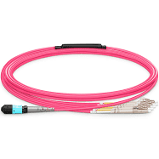
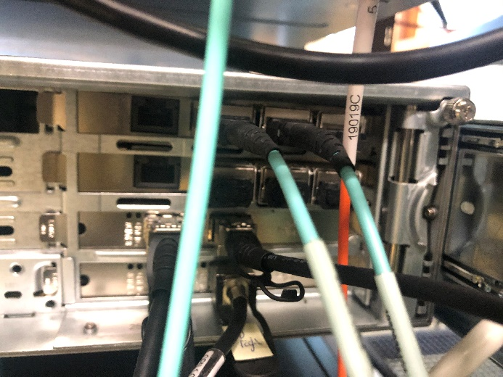
Digression on MROD Connections
MROD duplex channels (S-link protocol) connected to one of the two RobinNP in canche directly (no patch panel). Each RobinNP has 3 MPO-4-Duplex connectors.
MPO-to-4-LC-Duplex
Link 1÷6 to AGOGNA (BNL-711 or BNL-712?)
Simplex connection from MROD LC Data Tx
used to test the simplex transmission CSMs → FELIX-MROD. In this case, the regular MROD is used as external data generator, emulating the data output from the CSM (Chamber Service Modules)
MPO-to-4-LC-Duplex

Slide 8
MPO↔LC PP 3-2
MPO side: (48× Tx/Rx-crossed?) to AGOGNA (BNL-712?)
All used as loop-back

Slide 9
Overview
FELIX | FELIX Pair | MPO↔LC Cassette | Host
Turano FLX-712 | 24 | PP1 – Pair 24 | JJ VLDB

Slide 10
Optical Fanout ST
N.U.
N.U.
MROD TIM-3C
GIMONE (VC-709?)
TURANO (FXL-712)
AGOGNA (FXL-712)
From “Topo” Red Box
1.6 db in
10.1 db out

Slide 11
Optical Fanout ST
3. N.U.
5. N.U.
1. MROD TIM-3C
14. TURANO (FXL-712)
10. GIMONE (VC-709?)
15. AGOGNA (FXL-712)
1.6 db in (from “Topo Red Box”)
4.7 db in (from TTC vi/ex)
12.2 db out
10.1 db out
8.5 db
7.5 db

Slide 12
Next
to buy extra fiber network components, I need to know:
The exact optical connection configuration of each FPGA card (i.e. how many MPO8/12/24/48 they have)
FLX Users and use cases. In my count, I see:
Loop-back
VLDB Henk
VLDB JJ
Forthcoming ITk-strips → VLDB+ → FELIX (JJ)
Forthcoming ITk-pixel → VLDB+ → FELIX (JJ)
FLX MROD
FELIG → FELIX
Bas’ mezzanine → FELIX
TTC users and use cases
With one or two cheap extra ST fanouts, we can have TTCvi, Topo and future-Zinc simultaneously in use

